Slide 1

ContributING to madagascar
Jeff Shragge and Sergey Fomel
July 3, 2015
UWA Workshop

Slide 2


“Run a program as you wish, for any purpose you wish, not limited to any narrowly defined application.”
“Help yourself by improving the program (which requires
access to source code).”
“Help your neighbor by sharing a copy of the program with them.”
“Help community by sharing
the improved copy at large.“

Slide 3
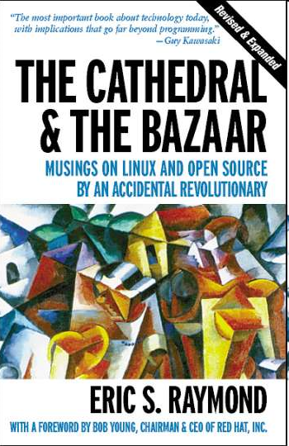
“Given a large enough beta-tester and co-developer base, almost every problem will be characterized quickly and the fix obvious to someone.”
"Given enough eyeballs, all bugs are shallow."

Slide 4




Free Software Examples
Linux kernel
GPL, 1991, Unix
GIMP
GPL, 1996, Photoshop
R project
GPL, 1993, S
Sage
GPL, 2005, MATLAB/Mathematica
Madagascar
GPL, 2006, SEPlib

Slide 5

GPL License
“Using the GNU GPL will require that all the released improved versions be free software. This means you can avoid the risk of having to compete with a proprietary modified version of your own work.”http://www.gnu.org/licenses/gpl-faq.html

Slide 6
http://connect.icrossing.co.uk/2013-mobile-market-share-infographic_10062

Slide 7
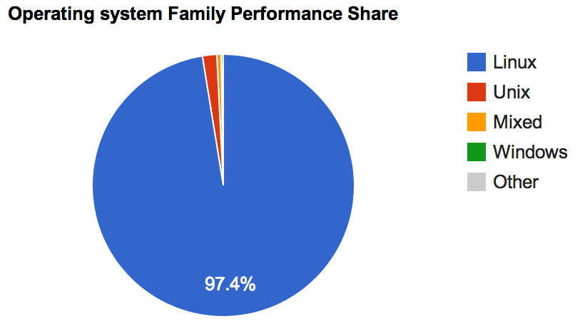

http://www.top500.org/

Slide 8
How to Add Your Own Programs
“Help yourself by improving the program…”
Create a directory for yourself or your group under $RSFSRC/user. Put your programs there.
Create SConstruct file in your directory by following examples from other user directories.
http://www.ahay.org/wiki/Adding_new_programs_to_Madagascar

Slide 9
How to Contribute Your Programs
“Help community by sharing the improved copy…”
Register at SourceForge. Send your SourceForge user name to one of the administrators.
Upload your files to the repository using svn add and svn commit.
Add reproducible examples of using your program under $RSFSRC/book.
http://www.ahay.org/wiki/Contributing_new_programs_to_Madagascar

Slide 10




Communication Tools
Wiki page http://www.ahay.org/
Blog http://www.ahay.org/rsflog/
Subversion repository (89 developers)
https://sourceforge.net/p/rsf/code/HEAD/tree/trunk/
Mailing lists (378 subscribers)
https://lists.sourceforge.net/lists/listinfo/rsf-user
https://lists.sourceforge.net/lists/listinfo/rsf-devel
SourceForge trackers
https://sourceforge.net/p/rsf/bugs/
https://sourceforge.net/p/rsf/feature-requests/
LinkedIn group (453 members)
http://www.linkedin.com/e/vgh/1847746

Slide 11

2016 Madagascar School?
Poland
Austria
South Korea
Brazil

Slide 12

2015/16 Working Workshop?
Field Data Processing
Seismic Interpretation
Documentation
C++/Java/Python/Fortran

Slide 13

Conclusions
Recognize Madagascar project as a community effort
Understand freedoms provided by open source
Use online communication tools to participate in the development and to connect with other users
Attend schools and working workshops

